Slide 1
Spider web simulation
Changrui Cai & Jiahua He

Slide 2

Question
When an insect flies into a spider's silk, what kind of deformation does the spider silk undergo?

Slide 3
Assumption
Young's modulus of spider silk ranges from 1.5 to 12 gigapascals. Our team choose 8 gigapascals in general.
The diameter ranges from 0.2mm to 1mm. Our team choose 0.5mm.
The adhesive force of spider silk ranges from 10^-6 to 10^-3 Newtons, depending on the spider species and the condition of the silk. On average, the adhesive force is around 10^-4 Newtons.

Slide 4
Simplify
The fly only contact with one string.
The captured insect will reach the maximum adhesive force of the spider silk during its struggle.
The spider silk will be simplified as a regular rod, the two ends of the rod are fixed. And the captured insect will be considered as a point applying force.
The direction of the force is perpendicular to the rod.
The process of insect attempting to escape after being captured.

Slide 5
Steps
Insect caught by spider silk. Spider silk has not deformed.
An upward force is applied to it. Spider silk undergoes deformation
Reaching maximum adhesion, spider silk undergoes maximum deformation

Slide 6
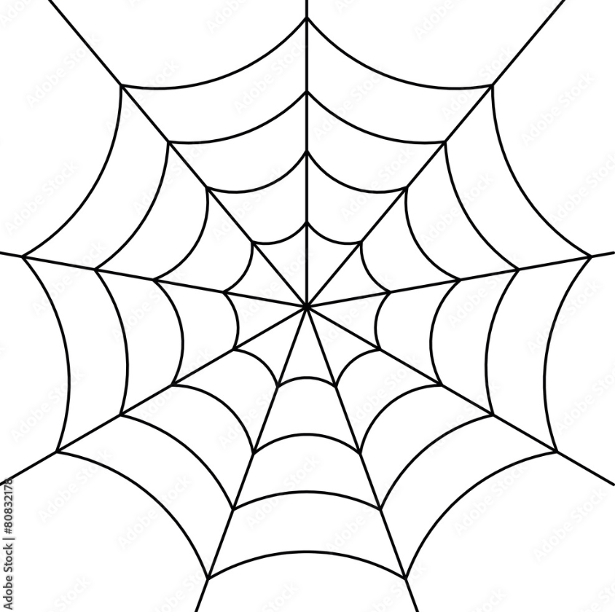
Plan
Single rod in 2-D
Single rod in 3-D
Combination of rods. (Web)

Slide 7
References
[1] M. Chen, Z. Wang, K. Li, X. Wang, and L. Wei, “Elastic and Stretchable Functional Fibers: A Review of Materials, Fabrication Methods, and Applications,” Advanced Fiber Materials, vol. 3, no. 1, pp. 1–13, Jan. 2021, doi: https://doi.org/10.1007/s42765-020-00057-5.
[2] Maria Gessica Ciulla, Alessio Massironi, Michela Sugni, M. A. Ensign, S. Marzorati, and Mahdi Forouharshad, “Recent Advances in the Development of Biomimetic Materials,” Gels, vol. 9, no. 10, pp. 833–833, Oct. 2023, doi: https://doi.org/10.3390/gels9100833.
[3] A. Powers, “Spider Silk: Sronger than Steel? Nature’s Supermaterial,” Berkeley Scientific Journal, vol. 18, no. 1, 2013, doi: https://doi.org/10.5070/bs3181020651.
[4] K. M. Babu, “Spider silks and their applications,” Silk, pp. 235–253, 2019, doi: https://doi.org/10.1016/b978-0-08-102540-6.00010-3.
[5] M. K. Jawed and S. Lim, Discrete Simulation of Slender Structures. 2022.
[6] O. M. O’Reilly, “Kirchhoff’s Rod Theory,” Interaction of mechanics and mathematics, pp. 187–268, Jan. 2017, doi: https://doi.org/10.1007/978-3-319-50598-5_5.

